Slide 1

Hospital management system (Patient movement)
Course Title: Simulation and Modelling
Course Code : CSE413
Thanjida Akhter

Slide 2
Hospital Management Systems
Hospital Management Systems can be defined as massive, integrated systems that support the comprehensive information requirements of hospitals, including patient, clinical, ancillary and financial management.
Hospitals are extremely complex institutions with large departments and units coordinate care for patients. Hospitals are becoming more reliant on the ability of HMS to assist in the diagnosis, management and education for better and improved services and practices.

Slide 3
Corporate model of hospital management system
Patient
Doctor
Admin
Abstract View

Slide 4
Patient
From the abstract view we can see that one of the main component of HMS is Patient.
Who is this Patient?
When we get injured or
Feel sickness or
Weakness
We become the Patient.
How Patient works in HMS ?

Slide 5
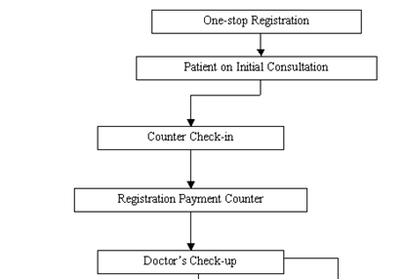
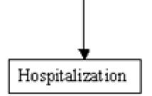
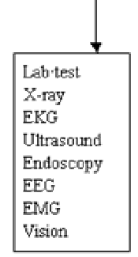
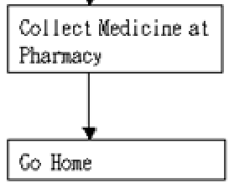
Examination??
No
Admit Patient?
No
Yes
Yes

Slide 6
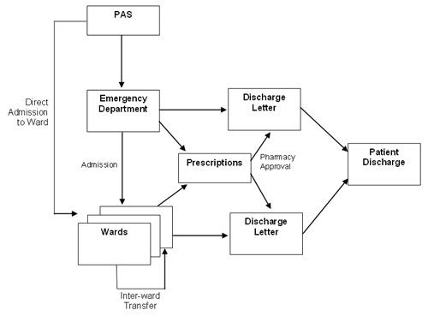
P. a. s.
Emergency ?
Hospitalization
No
Yes
Go Home

Slide 7


